Slide 1
Conceptualize and Infer User Needs in E-commerce
ADVISOR: JIA-LING KOH
PRESENTER: CHENG-WEI CHEN
SOURCE: CIKM’19
DATE: 2021/9/27

Slide 2
Outline
Introduction
Problem
Previous Work
Target

Slide 3
Problem
Historical behaviors
(User profile, User behaviors,
Item information, etc...)

Slide 4
Previous work
Hard for the recommender system to jump out of historical behaviors to explore other implicit user needs
Current recommender systems can only satisfy very limited user needs such as the needs for a particular category or brand

Slide 5
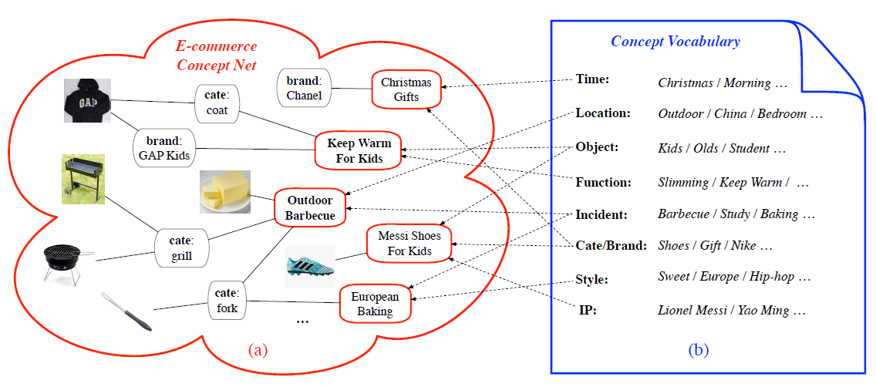
Target
Bridging concepts connect user and items to satisfy some high-level user needs or shopping scenarios such as “Outdoor Barbecue” and “Keep Warm for kids”

Slide 6
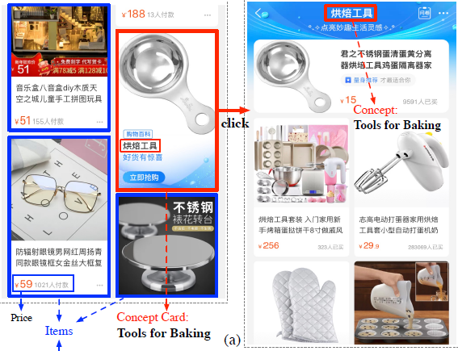
Target
Input
User Historical Behavior (item, behavior type, behavior time)
User Profile(gender, age level, kid’s gender, kid’s life stage, etc)
Concept (id, gender, age, etc)
Item(category, brand, shop,etc)
E-commerce Concept Net
Output: probability of user u will need concept c

Slide 7
Outline
Method
Architecture
Method detail
Loss function

Slide 8
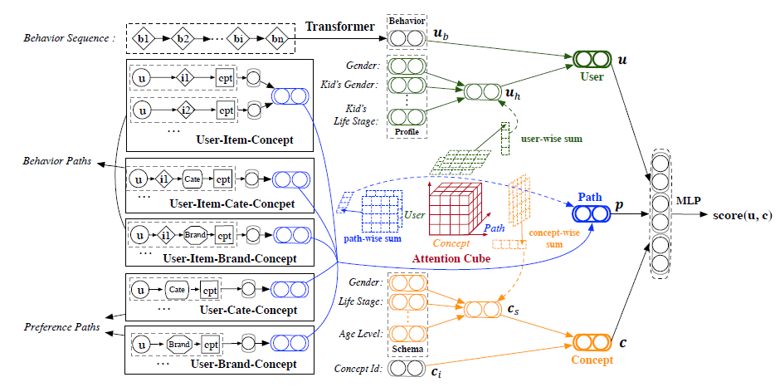
Architecture
User embedding
Path embedding
Concept embedding

Slide 9
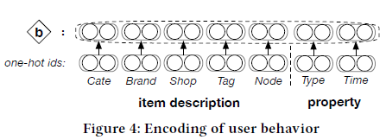
User Embedding
User Historical Behavior (item, behavior type, behavior time)
Low-dimensional of
dense vector

Slide 10
User Embedding
User Historical Behavior (item, behavior type, behavior time)
User Profile (gender, age level, kid’s gender, kid’s life stage, etc)
Average pooling
FC: Fully connected

Slide 11
Concept Embedding
Concept id embedding
Concept schema (gender, age, etc)
Average pooling
FC: Fully connected

Slide 12
Path Embedding
How do we know which Item-Concept relations should we choose?
Ans: by tf-idf score
User-Item-Concept (UIC)
User-Item-Cate-Concpet (UITC)
User-Item-Brand-Concept (UIBC)
User-Cate-Concept (UTC)
User-Brand-Concept (UBC)

Slide 13
Importance of each item-concept (tf-idf)
tf-idf
tf: How many the same description as item i in a concept
idf: How many concepts does item i appear in
For example:
Concept : Tools for baking
item : spoon
Concept: include totally 100 items
Same desciption as spoon: 10 items
tf: 10/100 = 0.1
Total Concept: 1000 kinds of concepts Spoon appears in 10 kinds of concepts
idf: log(1000/10) = 2
tf-idf = 0.1* 2 = 0.2

Slide 14
Path Embedding (Take UITC for example)
User Historical Behavior
Category id embedding
Item description embedding
Concept id embedding
Average pooling

Slide 15
Architecture
Attention cube (p17)
Average pooling (p11,p12,p15)
User embedding
Path embedding
Concept embedding

Slide 16
Attention Cube
j-th embedding of meta-path embedding list
i-th embedding of
user profile embedding list
k-th embedding of
concept schema embedding list

Slide 17
Output & loss function

Slide 18
Outline
Introduction
Method
Experiment
Conclusion

Slide 19
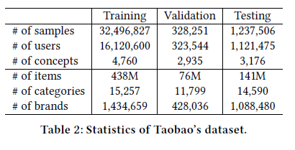
Dataset
During January 11 to January 14, 2019

Slide 20
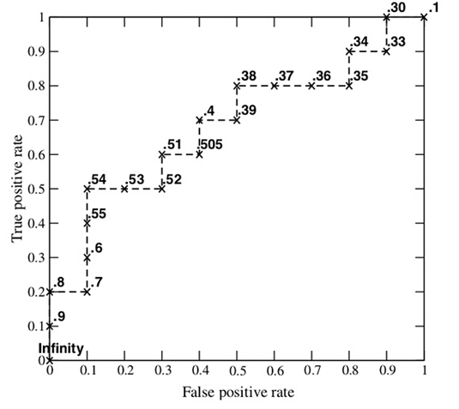
Experiment Method
AUC: Area under ROC curve
HR@k: Hit Ratio
NDCG@k: Normalized Discounted
Cumulative Gain
Relation

Slide 21
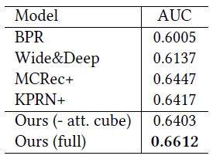
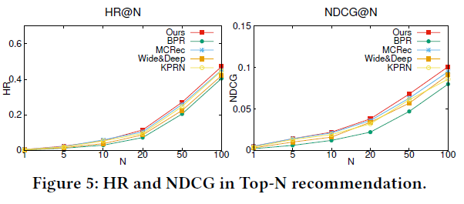
Experiment
Meta path with attention
Knowledge graph based

Slide 22
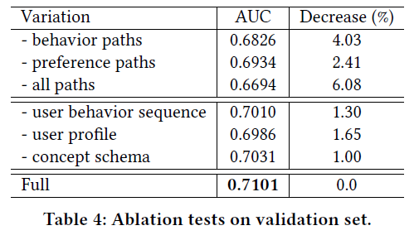
Experiment

Slide 23
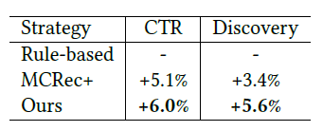
Experiment

Slide 24
Conclusion
We formally define user needs in e-commerce and introduce “e-commerce concept net”, where “concepts” can explicitly express various shopping needs for users.
Based on the e-commerce concept net, we propose a path based deep model with attention cube to infer user needs.
We evaluate our model outperforms several strong baselines, indicates the value of such user needs inference.

